Slide 1
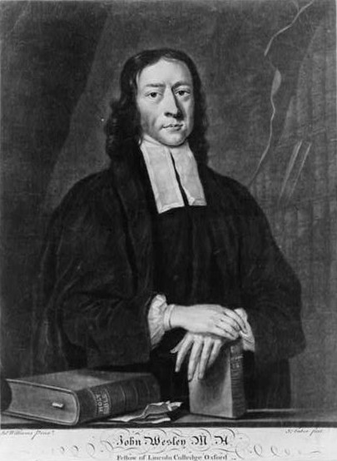

Slide 2
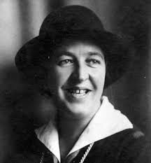

Slide 3


Slide 4
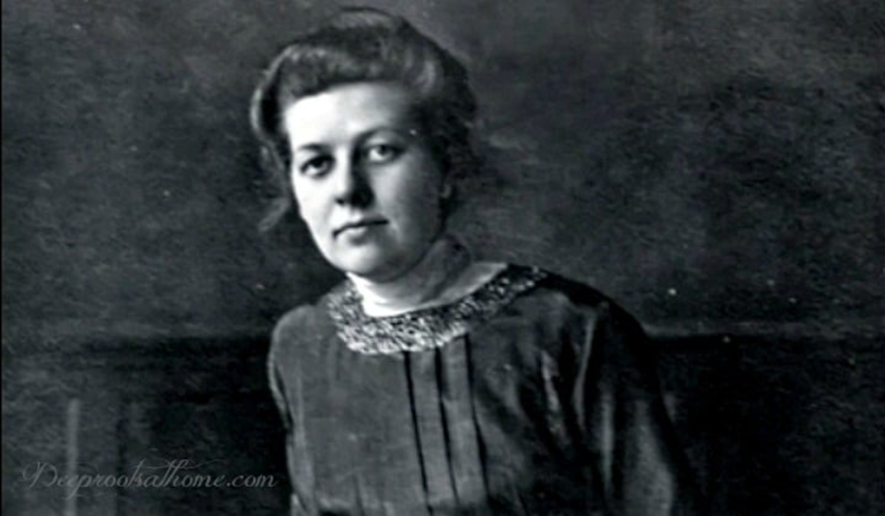

Slide 5
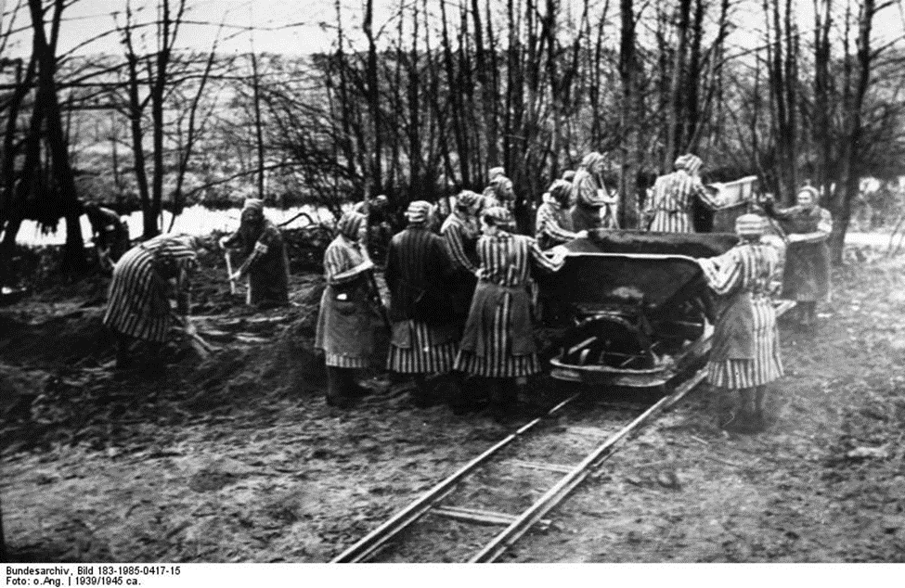

Slide 6
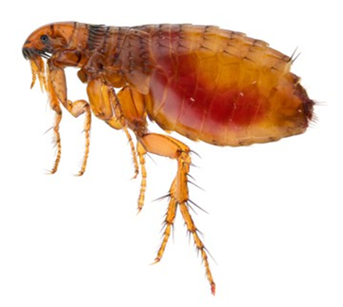

Slide 7
Let us give thanks to God our Father for all his gifts so
freely bestowed upon us.
For the beauty and wonder of your creation, in earth and
sky and sea.
We thank you, Lord.
For all that is gracious in the lives of men and women,
revealing the image of Christ,
We thank you, Lord.
now and for ever. Amen.

Slide 8
For our daily food and drink, our homes and families, and our friends,
We thank you, Lord.
For minds to think, and hearts to love, and hands to serve,
We thank you, Lord.
For health and strength to work, and leisure to rest and play,
We thank you, Lord.

Slide 9
For the brave and courageous, who are patient in suffering and faithful in adversity,
We thank you, Lord.
For all valiant seekers after truth, liberty, and justice,
We thank you, Lord.
For the communion of saints, in all times and places,
We thank you, Lord.

Slide 10
Above all, we give you thanks for the great mercies and promises given to us in Christ Jesus our Lord;
To him be praise and glory, with you, O Father, and the
Holy Spirit
Let us give thanks to God our Father for all his gifts so
freely bestowed upon us.
For the beauty and wonder of your creation, in earth and
sky and sea.
We thank you, Lord.

